Slide 1

Analytical CRM Development for a Bank
Capstone Project Presentation
By: Kumar Prakash

Slide 2
Agenda
Introduction & Objectives
Business context & Approach
Data Preparation & Analysis
Key Insights & KPIs
Recommendations & Next Steps

Slide 3
Objectives
Primary Objectives:
Identify key churn drivers
Segment profitable and at-risk customers
Recommend actionable retention strategies
Project Scope:
Data preparation and cleaning using SQL
Data analysis and visualization with Power BI dashboards
KPI tracking and storytelling to support business decisions

Slide 4
Business context & Approach
Business Context:
The bank aims to reduce customer churn, improve service delivery, and boost customer satisfaction using analytics.
Analytical Approach:
SQL for data consolidation, cleaning, and querying
Power BI for creating interactive dashboard and KPI monitoring
Data Sources:
Customer demographics, transaction records, churn status, product usage, and geography

Slide 5
Data Preparation & Methodology
Data Preparation:
Dataset consolidation from multiple tables (CustomerInfo, BankChurn, Geography, etc.)
Standardized data formats and trimmed categorical fields (SQL queries used)
Null checks and correction of discrepant data points (e.g., active members flagged incorrect when Exited = 1)
Methodology:
SQL queries for exploratory analysis and feature engineering
Power BI data model relationships: CustomerID, GeographyID, GenderID, etc
Bucketing features: Age, Tenure, CreditScore, Engagement

Slide 6
Key Insights & KPIs
Content:
Overall churn rate: approx. 20%
High churn among customers with low tenure and product usage
Customers with credit cards show slightly lower churn risk
Geographic trends: Germany and France show elevated churn rates
Aging cohorts (30-50) have the highest churn counts
KPIs displayed: Churn rate, average balance, active member distribution
Interactive slicers in dashboard to segment by Geography, Gender, Age, Credit Score

Slide 7
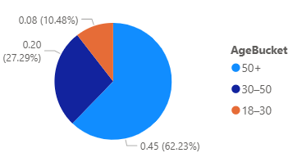
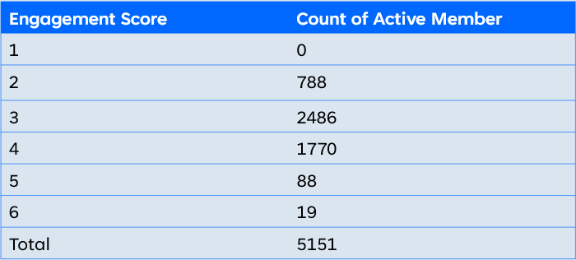
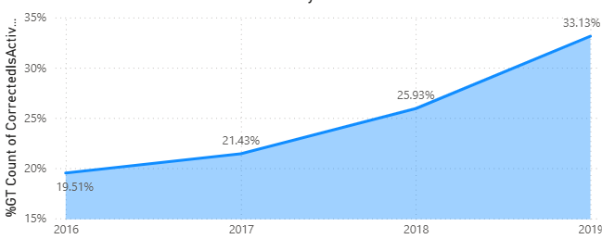
KPI Dashboard Highlights This dashboard summarizes key retention and churn KPIs across segments and time
Churn Rate by Age Bucket
Engagement Score by Active Member
%ag Count of Active Member by Year
Conclusion:
The 50+ age group has higher Churn Rate
18-30 age group has lower Churn Rate
Conclusion:
Most of the member has Engagement Score = 3.
Least of the member has Engagement Score = 6
No Active member has Engagement score = 1
Conclusion:
Active Member Over the year increases
In three year Active members become double

Slide 8
Customer Segmentation & Churn Analysis
Credit Score Segmentation:
Poor credit score segments have highest exit rates (~22%)
Excellent credit score segments show lowest churn
High-Value Customers:
Combination of high balance, multiple products, and active membership indicates high lifetime value (LTV)
Churn Patterns:
Customers aged 30-50 with low engagement and product adoption are at highest risk

Slide 9
Marketing Campaign Effectiveness
Evaluate how marketing campaigns influence:
Customer retention (preventing churn)
Customer acquisition (bringing in new customers)

Slide 10
Customer Exit Reasons Exploration
The average credit score of customers who exited is relatively low at around 645, indicating potentially higher credit risk.
Their average balance is moderately high (about ₹91,108), suggesting they had significant funds, which might make their churn impactful.
The average number of products held (1.475) shows they were engaged but not deeply diversified in bank offerings.
These trends suggest that customers leaving may be financially valuable but perhaps dissatisfied or seeking better options, emphasizing the need for proactive retention strategies focused on service quality and personalized offers.

Slide 11
Recommendation & Next Steps

Slide 12
Retention Strategies:
Reactivate inactive cohorts with engagement campaigns and onboarding flows for first 90-180 days
Geography-specific offers focusing on high-churn regions (Germany, France)
Cross-Selling & Upselling:
Promote product bundles and credit card rewards to increase engagement
Data Quality & Operational Improvement:
Fix data pipeline issues for IsActiveMember flag
Implement monthly churn reviews with leading indicators
Future Initiatives:
Build predictive churn propensity models
Run A/B tests on retention strategies and track KPIs monthly

Slide 13
Conclusion
Summary:
Churn concentrates primarily in low-tenure, low-engagement, and low-product groups
Data supported segmentation enables targeted, testable retention actions
Interactive dashboards empower leadership with ongoing KPI tracking

Slide 14
Thank you
Kumar Prakash
prakashgoyal.16417@gmail.com

